Slide 1
Mobile Operating Systems

Slide 2
Operating system and smartphone
Gone are the days when mobile phones were just a device to make phone calls and send occasional texts. Modern smartphones are closer to handheld computers that enable us to send emails, play games, watch the news and make video calls.
Operating systems are the software that runs our desktop computers and laptops and manages their resources and memory when they're being used for multi-tasking. Smartphones have their own operating systems – also known as a mobile OS. It's also a platform where developers can create applications or 'apps‘. There are a few main mobile device operating systems that the majority of smartphones run on, including Apple iOS, Google Android, and Microsoft's Windows Phone OS, Blackberry.

Slide 3
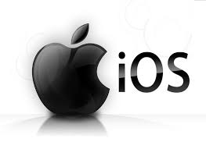
Apple iOS
The Apple iOS multi-touch, multi-tasking operating system is that runs Apple iPhones, iPads – and any iPods still in use – with a special version powering the Apple Watch too. Like most operating systems, iOS responds to the user's touch - allowing you to tap on the screen to open a program, pinch your fingers together to minimise or enlarge an image, or swipe your finger across the screen to change pages. You will only be able to use it on products made by Apple.

Slide 4
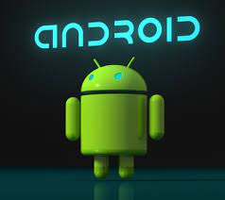
Android
Android OS is owned by Google and powered by the Linux kernel, which can be found on a wide range of devices.
Android is an open-source operating system that allows developers to access unlocked hardware and develop new programs as they wish.
This means it allows unlimited access to anyone who wants to develop apps. Some of the best features of Android include the ability to customize multiple home screens with useful widgets and apps that give you quicker, easier access to the content

Slide 5
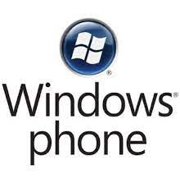
Microsoft Windows Phone
Even though it's one of the biggest computer operating systems, Microsoft's Windows phones are no longer being produced. And while you can still use your current Windows phone, the company discontinued updates in 2019. It has aggregators called 'hubs', that group together all photos from all applications, or all music into one library, meaning your Facebook photos can be found with your camera photos and your documents from different sources grouped together in one, easy-to-access location.

Slide 6
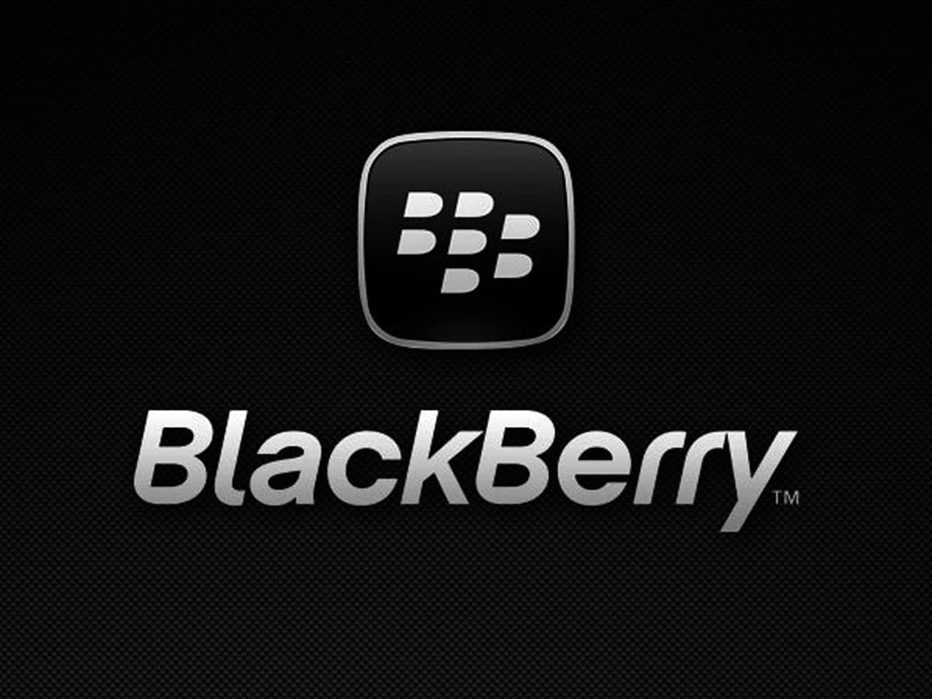
Blackberry OS
BlackBerry OS is a discontinued proprietary mobile operating system developed by Canadian company BlackBerry Limited for its BlackBerry line of smartphone handheld devices. The operating system provides multitasking and supports specialized input devices adopted by BlackBerry for use in its handhelds, particularly the trackwheel, trackball, and most recently, the trackpad and touchscreen. Updates to the operating system were automatically available from wireless carriers that support the BlackBerry over-the-air software loading (OTASL) service.

Slide 7
